Slide 1
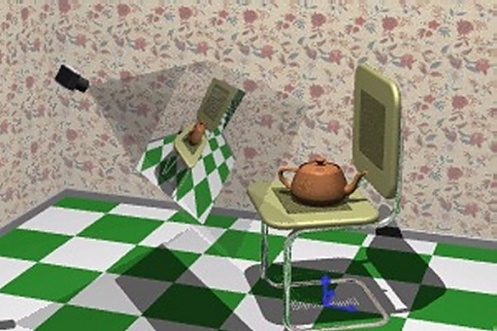
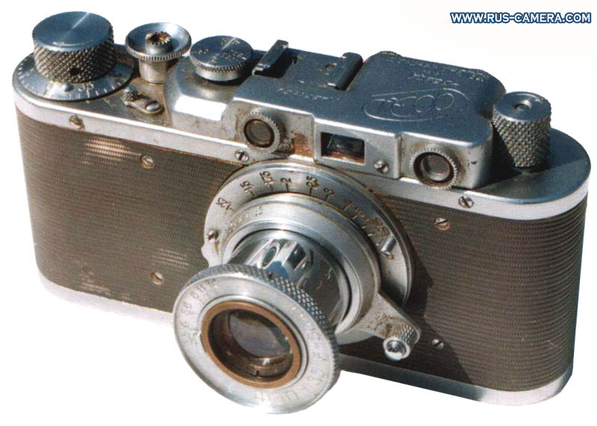
Camera Models & Augmented Reality
Last updated: 07-05-2020
Szeliski R., Computer Vision - Algorithms and Applications, Springer, 2011, Ch. 2
Solem, J. E., 2012. Programming Computer Vision with Python: Tools and algorithms for analyzing images. "O'Reilly Media, Inc.“, Ch. 4
Dr. Zulfiqar Habib, Professor
http://vig.cuilahore.edu.pk
Notes:
http://www.cs.cornell.edu/courses/cs6670/2009fa/lectures/lectures.html

Slide 2
Review
Geometric Transformation-3D.pptx
Image Registration.pptx

Slide 3
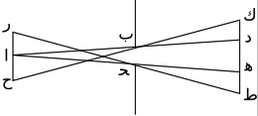
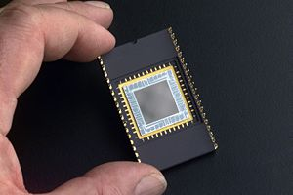
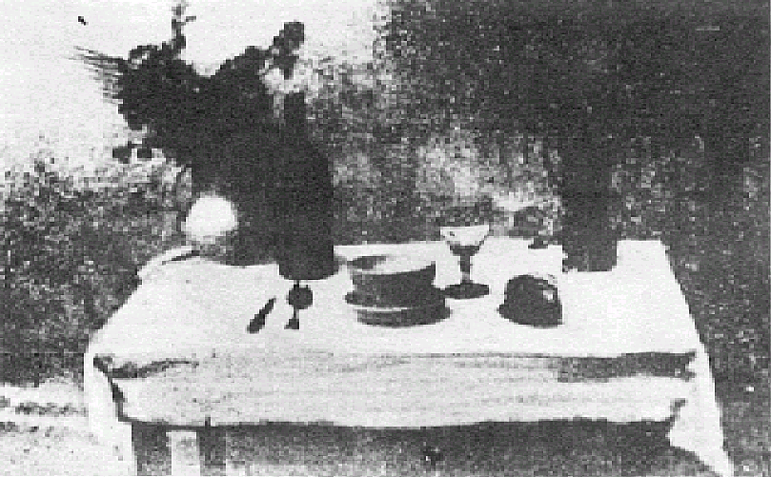
Historical Context
Pinhole model: Mozi (470-390 BC), Aristotle (384-322 BC)
Principles of optics (including lenses): Alhacen (965-1039)
Camera obscura (unclear): Leonardo da Vinci (1452-1519), Johann Zahn (1631-1707)
First photo: Joseph Nicephore Niepce (1822)
Daguerréotypes (1839)
Photographic film (Eastman, 1889)
Cinema (Lumière Brothers, 1895)
Color Photography (Lumière Brothers, 1908)
Television (Baird, Farnsworth, Zworykin, 1920s)
First consumer camera with CCD: Sony Mavica (1981)
First fully digital camera: Kodak DCS100 (1990)
Alhacen’s notes
Niepce, “La Table Servie,” 1822
CCD chip

Slide 4
Image Formation
Let’s design a camera
Idea 1: put a piece of film in front of an object
Do we get a reasonable image?

Slide 5
Pinhole Camera
Add a barrier to block off most of the rays
This reduces blurring
The opening known as the aperture
How does this transform the image?
Notes:
It gets inverted

Slide 6
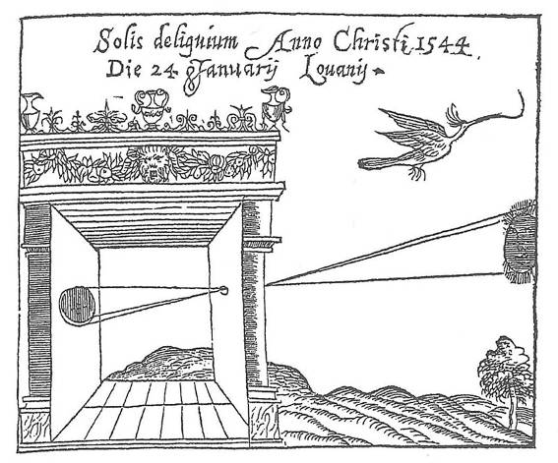
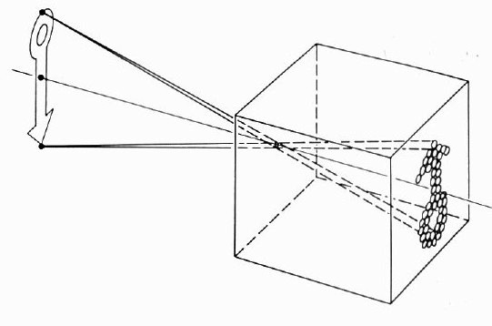
Pinhole Camera
Basic principle known to Mozi (470-390 BC), Aristotle (384-322 BC)
Drawing aid for artists: described by Leonardo da Vinci (1452-1519)
Gemma Frisius, 1558
Source: A. Efros

Slide 7
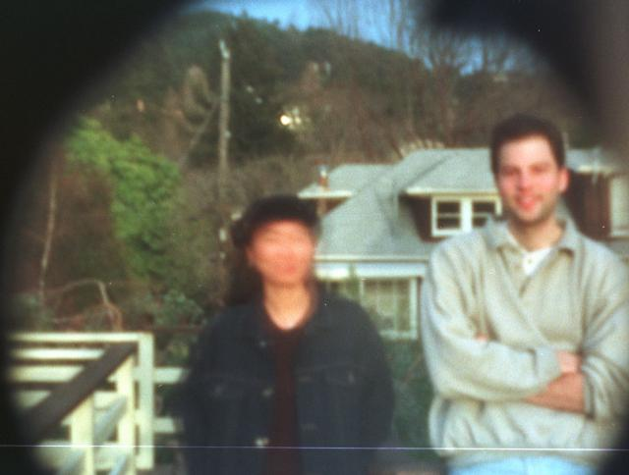
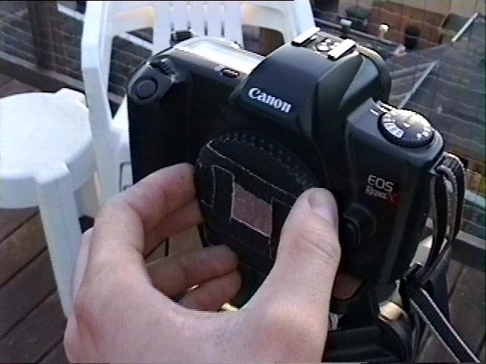
Pinhole Camera - Result
Home made pinhole camera
35mm Single-Lens Reflex Pinhole Photography
Why so blurry?
http://www.debevec.org/Pinhole/

Slide 8
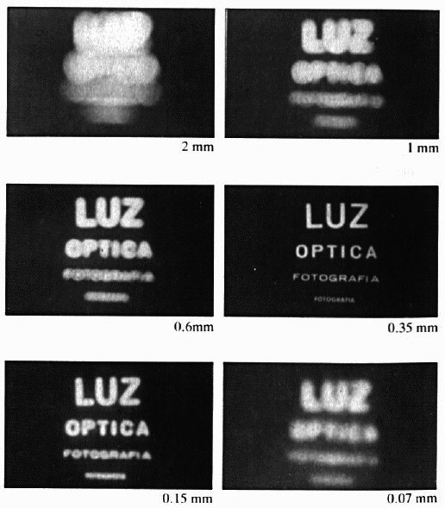
Shrinking the Aperture
Why not make the aperture as small as possible?
Less light gets through
Diffraction effects...

Slide 9
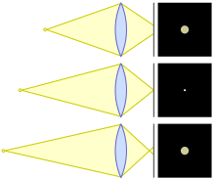
Adding a Lens
Lenses can be used
to gather light
to focus light
A lens focuses light onto the film
There is a specific distance at which objects are “in focus”
other points project to a “circle of confusion” in the image
Changing the shape of the lens changes this distance
Circle of confusion
Diagram showing circles of confusion for point source too close, in focus, and too far
Notes:
In optics, a circle of confusion is an optical spot caused by a cone of light rays from a lens not coming to a perfect focus when imaging a point source. It is also known as disk of confusion, circle of indistinctness, blur circle, or blur spot.

Slide 10

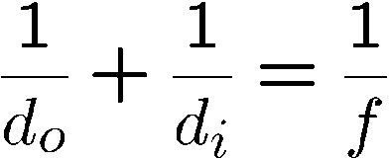
Adding a Lens
A lens focuses parallel rays onto a single focal point
focal point at a distance f beyond the plane of the lens:
f is a function of the shape and index of refraction of the lens
Aperture of diameter D restricts the range of rays:
aperture may be on either side of the lens
Lenses are typically spherical (easier to produce)
Lens
Aperture
Film
Focal point
D
Optical center
(Center of projection)
Focal length

Slide 11
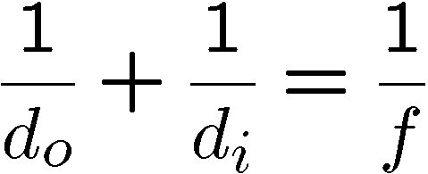
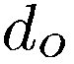
Thin Lens
Thin lens equation:
Any object point satisfying this equation is in focus
What is the shape of the focus region?
How can we change the focus region?
Object
Lens
Film
Not quite right…
Focal point

Slide 12
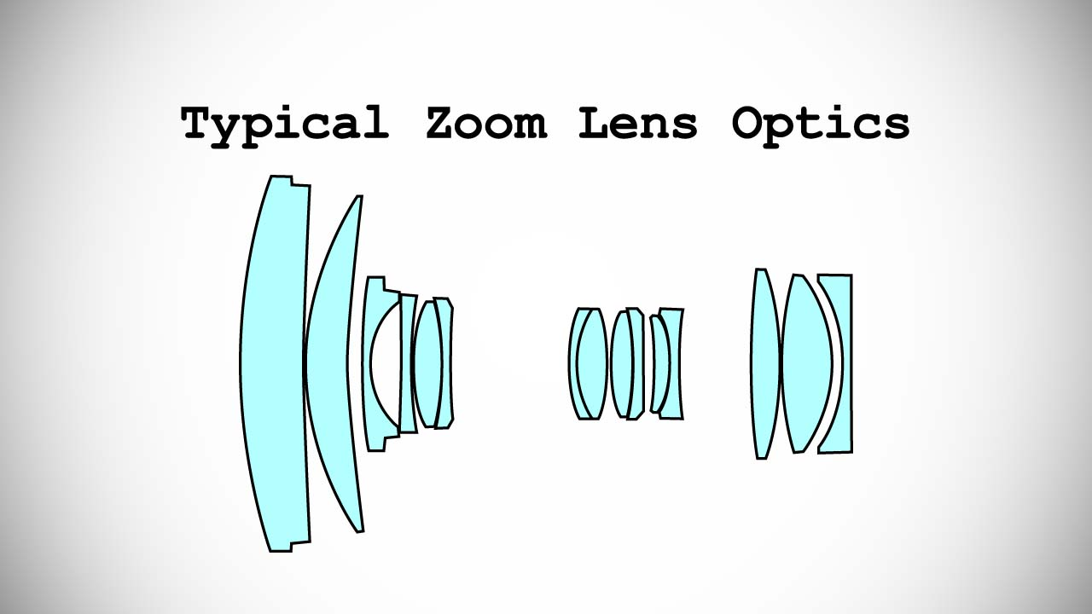
Thin Lens Assumption
The thin lens assumption assumes the lens has no thickness, but this isn’t true…
By adding more elements to the lens, the distance at which a scene is in focus can be made roughly planar.
Object
Lens
Film
Focal point

Slide 13
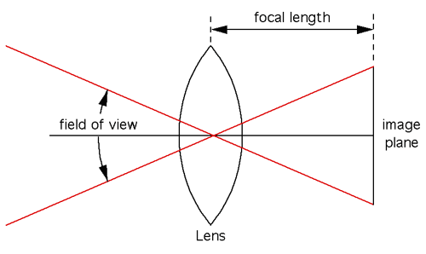
Field of View (FOV)
Part of the world that is visible through the camera at a particular position and orientation in space.
Objects outside the FOV when the picture is taken are not recorded in the photograph.
FOV is most often expressed as the angular size of the view cone, as an angle of view.
In human vision, the field of view is composed of two monocular FOVs which our brains stitch together to form one binocular FOV. Individually, our eyes have a horizontal FOV of about 135 degrees and a vertical FOV of just over 180 degrees.

Slide 14
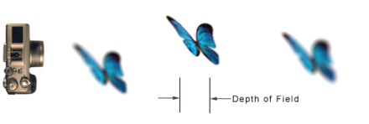
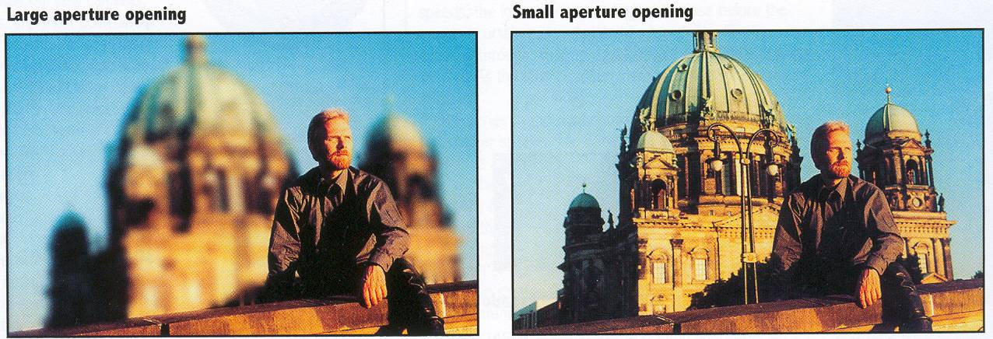
Depth of Field (DOF)
Changing the aperture size affects depth of field:
A smaller aperture increases the range in which the object is approximately in focus
Aperture
Film

Slide 15
Camera Parameters
Focus – Shifts the depth that is in focus.
Focal length – Adjusts the zoom, i.e., wide angle or telephoto lens.
Aperture – Adjusts the depth of field and amount of light let into the sensor.
Exposure time – How long an image is exposed. The longer an image is exposed the more light, but could result in motion blur.
ISO (International Organization for Standardisation) – Adjusts the sensitivity of the camera sensor. It is similar to a “gain” function in digital cameras. Increasing ISO brightens the image but also introduces more noise.

Slide 16
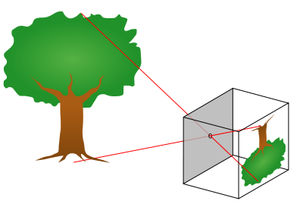
Camera Projection - 3D World to 2D Image (Perspective)
The Pinhole Camera Model
Light passes through a small aperture – the Pinhole
An image is formed on the back of the Camera
For each point in the scene there is one line through the pinhole, so one image point.

Slide 17
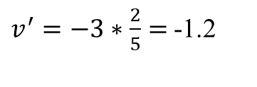
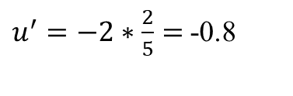
Camera Projection: World Coordinates→Image Coordinates
.
.
.
3
f
5
y
2
z
v’
?
.
Camera Center (0, 0, 0)
u’
If f = 2; Camera position: (0, 0, 0);
Camera direction = (0, 0, 1); X = (x, y, z) = (2, 3, 5);
What are u’ and v’?
$u^{′}=−2∗\frac{2}{5}=$-0.8
$v^{′}=−3∗\frac{2}{5}=$-1.2
Notes:
Being a little loose about coordinates vs lengths u and v prime because they are in the same coordinate system as x, y, and z but in later slides u and v will be –u’ and –v’ because they are in their own coordinate system which is mirrored

Slide 18
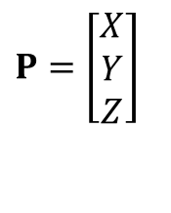
Camera Projection: World Coordinates→Image Coordinates
.
$$P=\left[\begin{matrix}X \\ Y \\ Z\end{matrix}\right]$$
Optical Center (u₀, v₀)
.
.
f
Z
Y
.
v
Camera Center (t_{x}, t_{y}, t_{z})
u
How do we handle the general case?

Slide 19
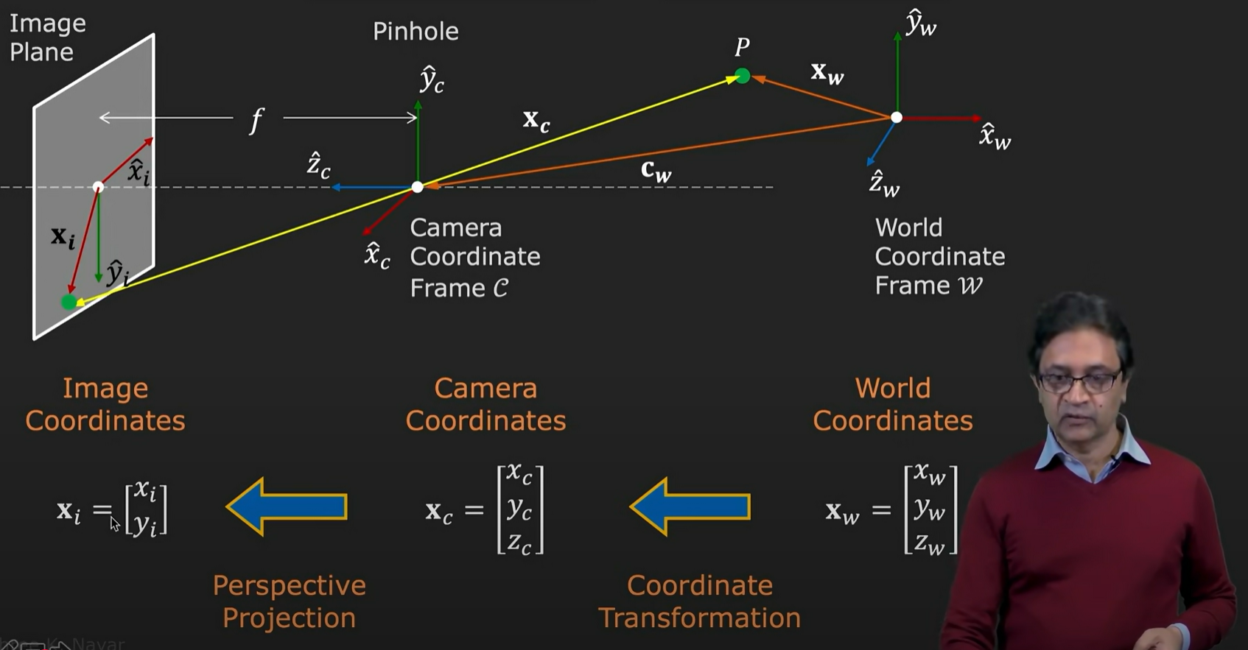
Camera Projection: Watch @ YouTube
Notes:
https://youtu.be/qByYk6JggQU?si=nnoP2KIm_wUnJazP

Slide 20
Camera Calibration
is the process of determining the parameters of a camera to correct distortions and map 3D world coordinates to 2D image coordinates accurately.
You can use these parameters to correct lens distortion, measure the size of an object in world units, or determine the location of the camera in the scene.
These tasks are used in applications such as machine vision to detect and measure objects. They are also used in robotics, for navigation systems, and 3-D scene reconstruction.

Slide 21
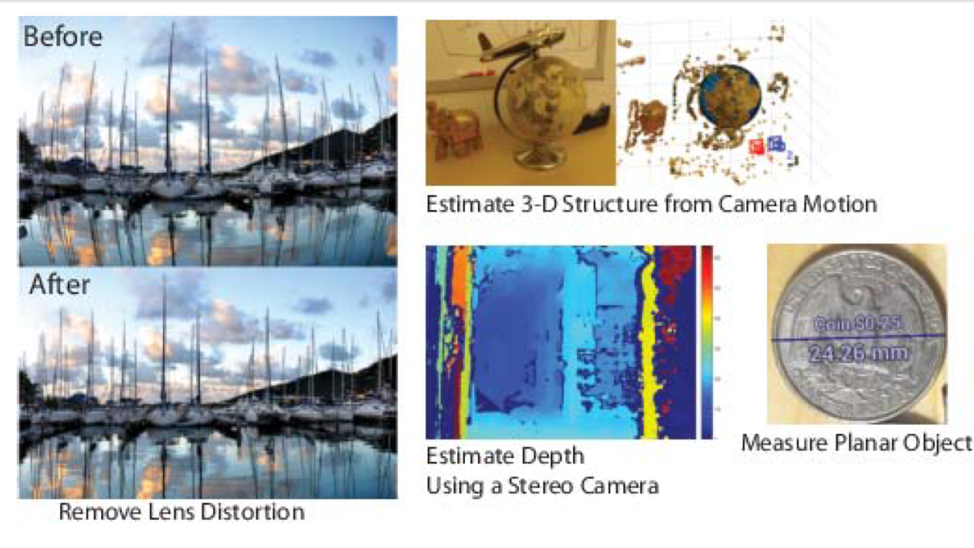
Camera Calibration - Applications

Slide 22
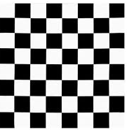
Camera Calibration Parameters
Camera parameters include intrinsics, extrinsics, and distortion coefficients. To estimate the camera parameters, you need to have 3-D world points and their corresponding 2-D image points.
You can get these correspondences using multiple images of a calibration pattern, such as a checkerboard. Using the correspondences, you can solve for the camera parameters.

Slide 23
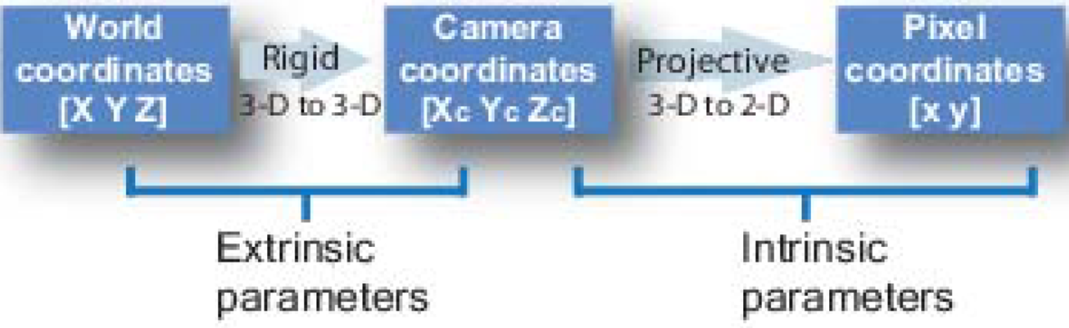
Camera Calibration Parameters
The calibration algorithm calculates the camera matrix using the extrinsic and intrinsic parameters.
The extrinsic parameters represent a rigid transformation from 3-D world coordinate system to the 3-D camera’s coordinate system.
The intrinsic parameters represent a projective transformation from the 3-D camera’s coordinates into the 2-D image coordinates.

Slide 24
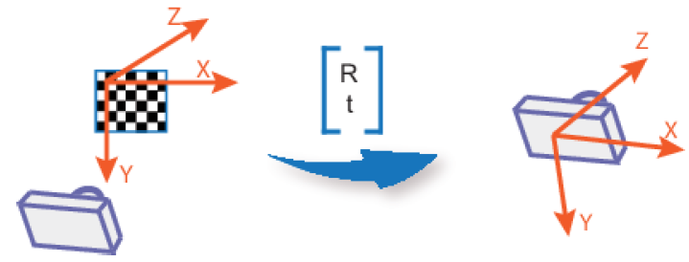
Camera Calibration Parameters
The extrinsic parameters consist of a rotation, R, and a translation, t. The origin of the camera’s coordinate system is at its optical center and its x- and y-axis define the image plane.

Slide 25
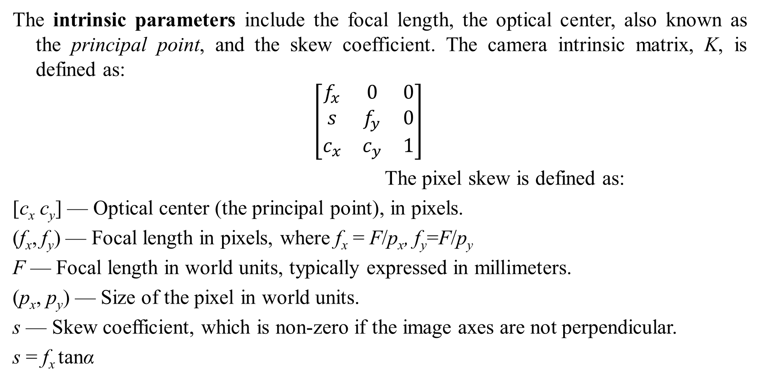
Camera Calibration Parameters
The intrinsic parameters include the focal length, the optical center, also known as the principal point, and the skew coefficient. The camera intrinsic matrix, K, is defined as:
$$\left[\begin{matrix}f_{x} & 0 & 0 \\ s & f_{y} & 0 \\ c_{x} & c_{y} & 1\end{matrix}\right]$$
The pixel skew is defined as:
[c_{x} c_{y}] — Optical center (the principal point), in pixels.
(f_{x}, f_{y}) — Focal length in pixels, where f_{x} = F/p_{x}, f_{y}=F/p_{y}
F — Focal length in world units, typically expressed in millimeters.
(p_{x}, p_{y}) — Size of the pixel in world units.
s — Skew coefficient, which is non-zero if the image axes are not perpendicular.
s = f_{x} tanα

Slide 26
Camera Calibration Parameters
After you calibrate a camera, to evaluate the accuracy of the estimated parameters, you can:
Plot the relative locations of the camera and the calibration pattern
Calculate the reprojection errors.
Calculate the parameter estimation errors.

Slide 27
Distortion in Camera Calibration
The camera matrix does not account for lens distortion because an ideal pinhole camera does not have a lens.
To accurately represent a real camera, the camera model includes the radial and tangential lens distortion.
Radial distortion occurs when light rays bend more near the edges of a lens than they do at its optical center. The smaller the lens, the greater the distortion.

Slide 28
Distortion in Camera Calibration
The radial distortion coefficients model this type of distortion. The distorted points are denoted as (x_{distorted}, y_{distorted}):
x_{distorted} = x(1 + k₁*r² + k₂*r⁴ + k₃*r⁶)
y_{distorted}= y(1 + k₁*r² + k₂*r⁴ + k₃*r⁶)
x, y — Undistorted pixel locations. x and y are in normalized image coordinates. Normalized image coordinates are calculated from pixel coordinates by translating to the optical center and dividing by the focal length in pixels. Thus, x and y are dimensionless.
k₁, k₂, and k₃ — Radial distortion coefficients of the lens.
r²: x² + y²
Typically, two coefficients are sufficient for calibration. For severe distortion, such as in wide-angle lenses, you can select 3 coefficients to include k₃.

Slide 29
Distortion in Camera Calibration
Tangential distortion occurs when the lens and the image plane are not parallel. The tangential distortion coefficients model this type of distortion.

Slide 30
Distortion in Camera Calibration
The distorted points are denoted as (x_{distorted}, y_{distorted}):
x_{distorted} = x + [2 * p₁ * x * y + p₂ * (r² + 2 * x²)]
y_{distorted} = y + [p₁ * (r² + 2 *y²) + 2 * p₂ * x * y]
x, y — Undistorted pixel locations. x and y are in normalized image coordinates. Normalized image coordinates are calculated from pixel coordinates by translating to the optical center and dividing by the focal length in pixels. Thus, x and y are dimensionless.
p₁ and p₂ — Tangential distortion coefficients of the lens.
r²: x² + y²

Slide 31
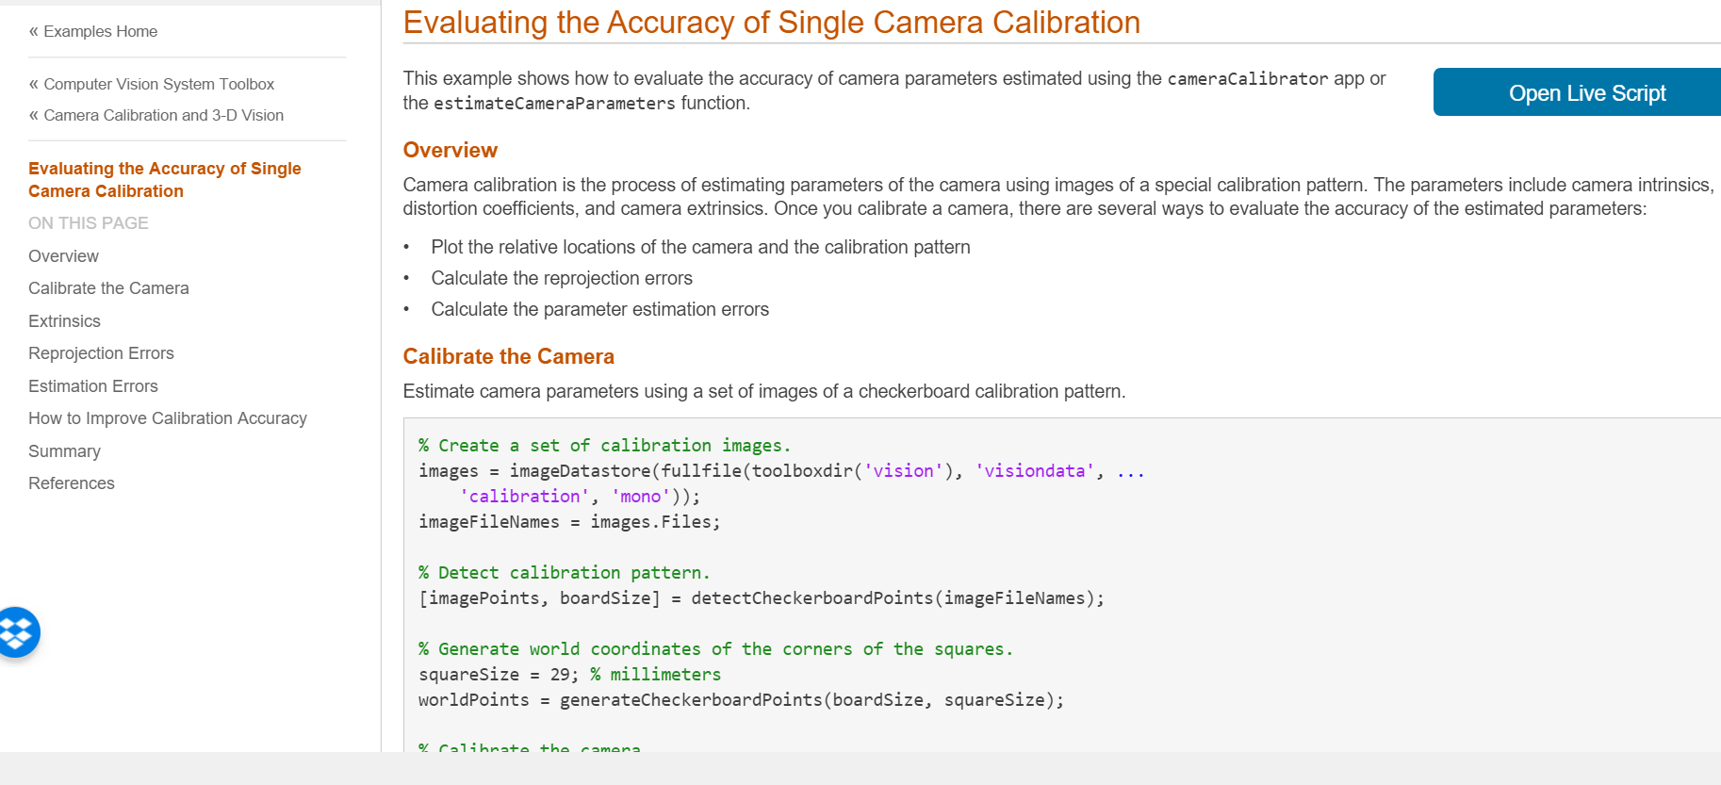
Camera Calibration - Example
Notes:
MatLab: EvaluatingCameraCalibrationExample.mlx
[1] Z. Zhang. A flexible new technique for camera calibration. IEEE Transactions on Pattern Analysis and Machine Intelligence, 22(11):1330-1334, 2000.

Slide 32
Augmented Reality (AR)
AR is a collective term for placing objects and information on top of image data.
3D AR is an interactive experience of a real-world environment where the objects that reside in the real world are enhanced by computer-generated perceptual information, sometimes across multiple sensory modalities.
AR can be defined as a system that fulfills three basic features: a combination of real and virtual worlds, real-time interaction, and accurate 3D registration of virtual and real objects.
Notes:
https://en.wikipedia.org/wiki/Augmented_reality

Slide 33
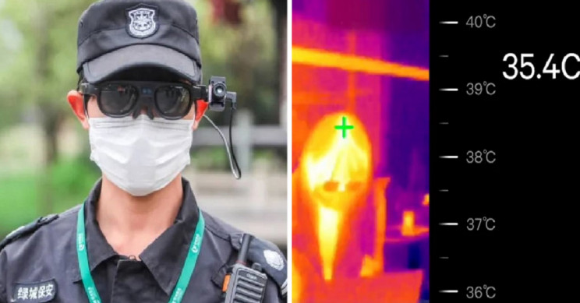
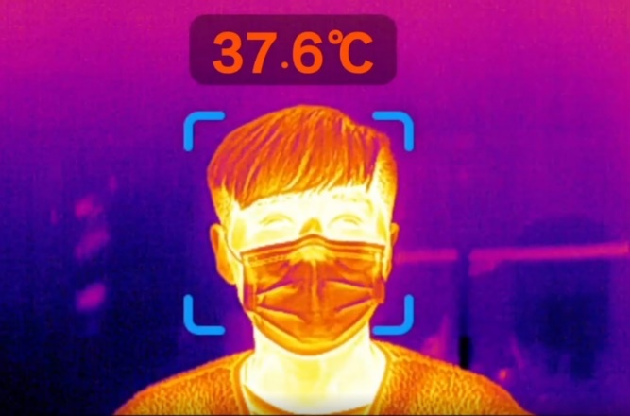
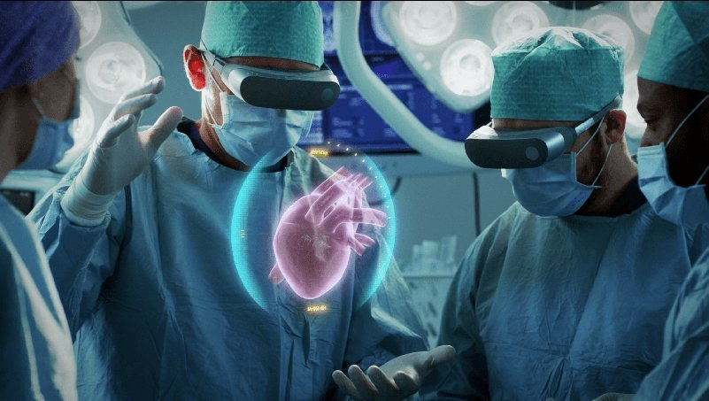

AR Applications
AR COVID-19 Glasses allow you to "See" the temperature of those around you.
AR in Healthcare.
Tourism Made Easier with AR Apps.
Notes:
https://interestingengineering.com/ar-covid-19-glasses-allow-you-to-see-the-temperature-of-those-around-you
https://www.cubix.co/blog/5-real-world-applications-of-augmented-reality-you-hadnt-thought-of

Slide 34

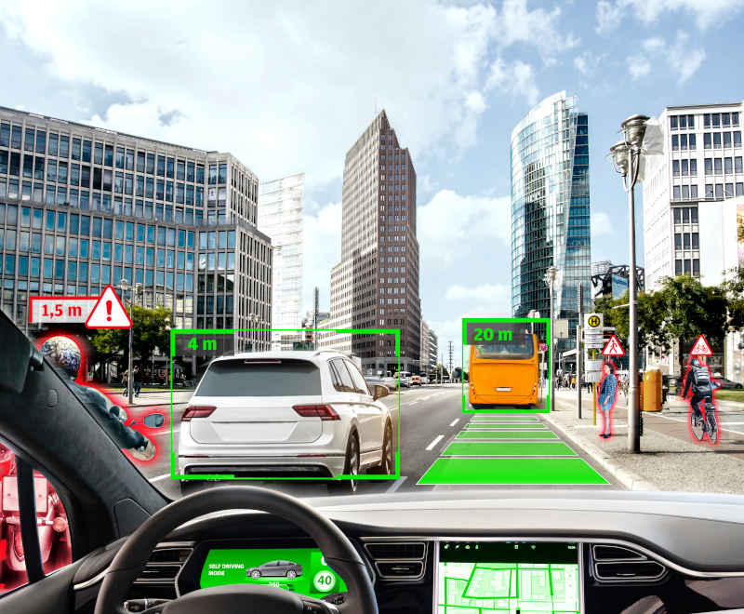

AR Applications
AR Transforming the Retail Industry.
Autonomous Vehicles and AR.
Indoor Navigation with AR.
Notes:
https://interestingengineering.com/ar-covid-19-glasses-allow-you-to-see-the-temperature-of-those-around-you
https://www.cubix.co/blog/5-real-world-applications-of-augmented-reality-you-hadnt-thought-of

Slide 35
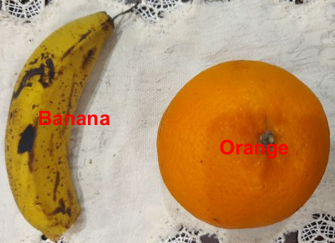
AR – Non-Classic Examples
Fruits_identification.mlx
CarTrackingCountingLightDarkAll.m

Slide 36


AR – Non-Classic Examples
Google Lens: Real-time translation onto the real object and virtual searching using device camera.

Slide 37
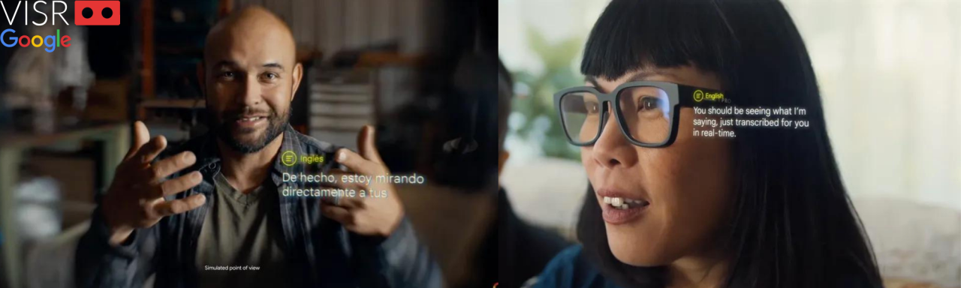
AR – Non-Classic Examples
Transcribe Glasses: Smart eyewear designed to convert spoken words into written text in real-time using speech recognition technology.
Notes:
https://www.linkedin.com/pulse/google-glass-revival-visr-vr?trk=article-ssr-frontend-pulse_more-articles_related-content-card

Slide 38

AR – Examples
Notes:
https://www.linkedin.com/pulse/google-glass-revival-visr-vr?trk=article-ssr-frontend-pulse_more-articles_related-content-card

Slide 39
Extra Stuff

Slide 40
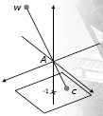
Camera Projection
The Pinhole Camera Model
Consider a pinhole camera in 3D space
The aperture, A, is at the origin
The image plane 1 unit down the Z axis, parallel to the X-Y plane
Any point, w, in the world projects to some point, c, on the camera plane
Notes:
http://www.cs.nott.ac.uk/~tpp/teaching.htm

Slide 41
3D World to a 2D Image
We want to find the relationship between w and c
We can represent these as 3D points w = [X, Y, Z]^{T}
c = [x, y, -1]^{T}
We want some matrix, P, so that c = P w
This matrix, P, is called the Projection Matrix
We can find it from the observation that w, c, and A (the origin) all lie on a line
So w and c must be some multiple of each other

Slide 42
The Projection Matrix
Since w and c are multiples of each other
c = s w => [x, y, -1]^{T} = s[X, Y, Z]^{T}
So we have x = sX, y = sY, -1=sZ
Therefore s=-1/Z
Giving us x = -X/Z, y = -Y/Z
So we end up with
But the matrix, P, depends on the value of Z, and we want one matrix P for all points
Homogeneous coordinates can help

Slide 43
The Projection Matrix
Recall from review:
We can represent a 3D vector [x, y, z]^{T} as a set of 4D vectors
So any 4D vector [x, y, z, k]^{T} corresponds to a 3D point
[x/k, y/k, z/k]^{T}
Note that this brings in a division by k
In the formulae we have for [x, y, -1]^{T} we have a division by –Z
So we choose things so that k = -Z, and rewrite the projection using homogeneous coordinates

Slide 44
The Projection Matrix
c = Pw

Slide 45

Properties of Projection
Looking at the projection matrix, P
The last column is all zeroes, and the last row is –1 times the second last
This means that P is not invertible, so while we can find c from w as c=Pw, we cannot find w as w=P⁻¹c
This is because each camera point relates to many world points

Slide 46
Properties of Projection
Preserves
Lines and conics
Incidence (whether a point lies on a line)
Invariants (cross-ratio)
can show that the only transformations that preserve lines and incidence are the projective transformations
Does not preserve
Lengths
Angles
Parallelism

Slide 47
More General Cameras
We have assumed that the camera
has an image plane 1 unit away from the pinhole aperture
looks along the Z axis
is located the origin
It is useful to have a more flexible model of a camera
We can relax all these assumptions
Having a different distance from the aperture is a scale
Looking in a different direction is a rotation
Moving away from the origin is a translation

Slide 48
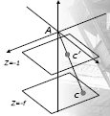
Focal Length & Scale
If the image plane is some distance, f, from the origin
f is called the focal length of the camera
The image coordinates have the form
c = [x, y, -f, 1]^{T}
We can relate this to a second camera
with f = 1, and image point
c’ = [x’, y’, -1, 1]^{T}

Slide 49
Focal Length & Scale
So a camera with focal length f is just a scaling, S, of our original camera
The focal length is the distance from the pinhole to the image plane
We sometimes apply similar scaling for different sized pixels
c’ = S c

Slide 50
Direction & Rotation
Next we consider a camera that looks in a different direction
Recall from review, any rotation can be represented by a matrix of the form
Given any camera at the origin
We can find some rotation, R, that turns that camera into a camera looking along the Z axis
We can then find a scale, S, which accounts for the camera’s focal length

Slide 51
Location & Translation
Finally the camera may not be at the origin
Again a matrix can represent this a translation
So for any camera location
We can find a translation, T, that will bring the camera to the origin
We can then apply a rotation so that it looks along the Z axis, and a scale to account for the focal length

Slide 52
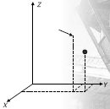
Example
We have a camera with focal length 1.5, direction along the line 45º between the X and Y axes, and location (2, 5, 7). Where does the world point (2, 6, 5) appear in the camera plane?
Note: A vector equally inclined toward X and Y-axes with no Z-component can be written as: d = (a, a, 0), where a is a scalar, e.g., (1, 1, 0)
PS: World point should be in the range of camera (FOV)
Notes:
A camera with a focal length of 1.5 is located at (2, 5, 7) and has its viewing direction aligned with the vector (1, 1, 0). Where will the world point (2, 6, 5) appear on the camera plane?

Slide 53
Example
The basic plan
We apply transformation to make it a ‘standard camera’
We apply the same transformation to the point
We then see where the point appears in the transformed camera

Slide 54
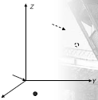
Step 1: Translation
The camera is not at the origin, so
We apply a translation
The translation is

Slide 55
Step 2: Rotation
The camera is not pointing along the Z axis, so we rotate it
We can view this as two rotations:
A rotation of 45º from the X to Y axes leaves us looking along the Y axis
A rotation of 90º from Y to Z then leaves us looking along Z

Slide 56


Step 2: Rotation
Rotate around Z axis by 45º
Rotate around X axis by 90º

Slide 57

Step 3: Scaling
Finally the focal length of the camera is not 1, so we scale

Slide 58
Putting it all together
Now we have a series of transformations
A translation
Two rotations
A scaling
We apply them to the point (2,6,5)
Note that order is important, both in matrix multiplication and the geometric interpretation
The original point in homogenous world coordinates
w = [2,6,5,1]^{T}
The transformed point is then w’=S R_{X} R_{Z} T w

Slide 59
And a bit of arithmetic

Slide 60
And finally a projection
After the transforms
The point and camera are in a ‘standard’ setup
We can apply the projection matrix
Therefore, position of point on camera plane is (1, -2.8)
Is it correct?

Slide 61
Exercise
Write a code to determine where a point in the real world appears on the camera plane, given the camera's focal length, direction, location, and the 3D coordinates of the point. Test the previous example to verify the result. For example:
Input:
Enter the focal length of the camera: 1.5
Enter the camera position (x y z): 2 5 7
Enter the camera direction vector (dx dy dz): 1 1 0
Enter the 3D point coordinates (X Y Z): 2 6 5
Output:
Point on the camera plane: 0 -2.8 (Is it correct?)
Notes:
Projection.ipynb

Slide 62
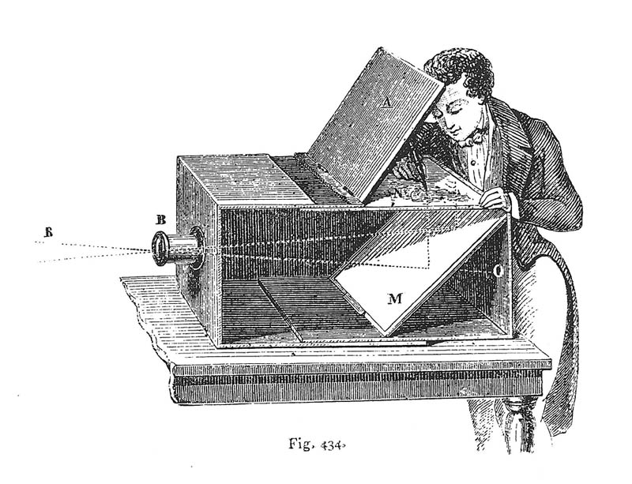
Before Film Was Invented
Lens Based Camera Obscura, 1568

Slide 63
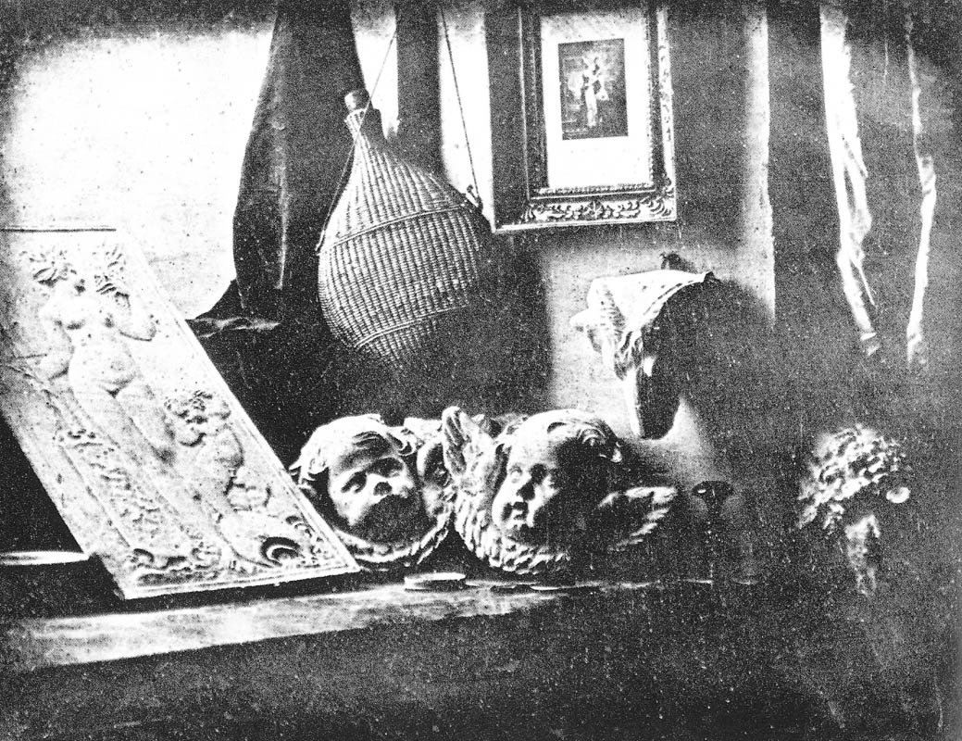
Film Camera
Still Life, Louis Jaques Mande Daguerre, 1837

Slide 64




Color
Most digital images are comprised of three color channels – red, green, and, blue – which combine to create most of the colors we can see
Why are there three?
=

Slide 65
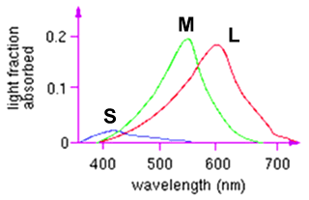
Color perception
L response curve
Three types of cones
Each is sensitive in a different region of the spectrum
but regions overlap
Short (S) corresponds to blue
Medium (M) corresponds to green
Long (L) corresponds to red
Different sensitivities: we are more sensitive to green than red
varies from person to person (and with age)
Colorblindness—deficiency in at least one type of cone

Slide 66

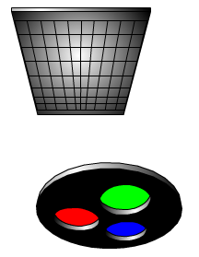
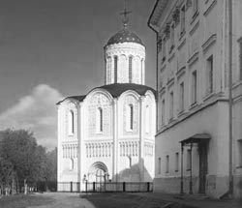
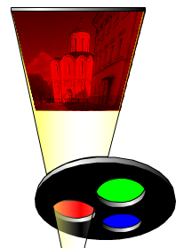
Field sequential
YungYu Chuang’s slide

Slide 67
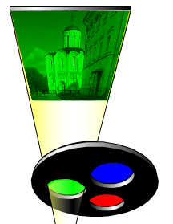
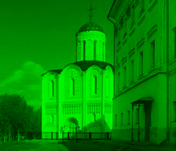
Field sequential
YungYu Chuang’s slide

Slide 68

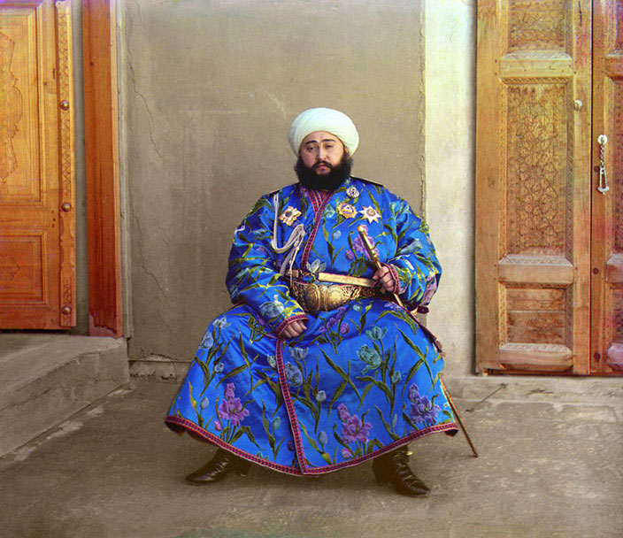
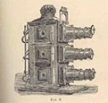


Prokudin-Gorskii (early 1900’s)
Lantern
projector
http://www.loc.gov/exhibits/empire/

Slide 69

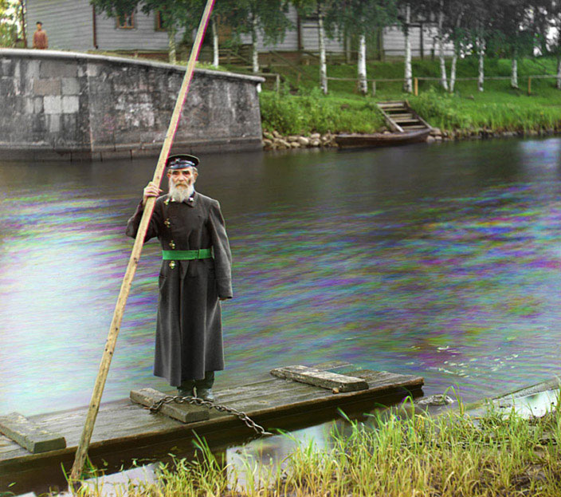
Prokudin-Gorskii (early 1990’s)

Slide 70


Color sensing in camera: Prism
Requires three chips and precise alignment
More expensive
CCD(R)
CCD(G)
CCD(B)

Slide 71

Sport photography
Why do they have such big lenses?
Dirkus Maximus

Slide 72
Causes of Noise
Shot noise – variation in the number of photons (low light situations.)
Readout noise – Noise added upon readout of pixel. In some cases can be subtracted out.
Dark noise – Noise caused by electrons thermally generated. Depends on the temperature of device.

Slide 73

The Eye
The human eye is a camera
Iris - colored annulus with radial muscles, responsible for controlling the diameter and size of the pupil and thus the amount of light reaching the retina.
Pupil - the hole (aperture) whose size is controlled by the iris
What’s the “film”?
Photoreceptor cells - (rods and cones) in the retina
Notes:
Note that the retina is curved

Slide 74

Silicon Image Detector
Silicon Image Detector, 1970

Slide 75



Digital camera
CCD vs. CMOS
Low-noise images
Consume more power
More and higher quality pixels
More noise (sensor area is smaller)
Consume much less power
Popular in camera phones
Getting better all the time
http://electronics.howstuffworks.com/digital-camera.htm

Slide 76

Mega-pixels
Are more mega-pixels better?
More mega-pixels require higher quality lens.

Slide 77
Why Calibrate?
Want to solve for 3D geometry
Alternative approach
Solve for 3D shape without known cameras
Structure from motion (unknown extrinsics)
Self calibration (unknown intrinsics & extrinsics)
Why bother pre-calibrating the camera?
Simplifies the 3D reconstruction problem
fewer parameters to solve for later on
Improves accuracy
Not too hard to do
Eliminates certain ambiguities (scale of scene)

Slide 78



Applications
3D Modeling
Match Move
Image-Based Rendering
Images courtesy of Brett Allen (“Vision for Graphics”, winter `01)
Light field capture
and rendering
(Levoy & Hanrahan, 96)

Slide 79
Camera Parameters
So far we’ve talked about:
focal length
principal (and nodal) point
radial distortion
CCD dimensions
aperture
There is also
optical center
orientation
digitizer parameters

Slide 80
Do we need all this stuff?
Usually simplify to “computable stuff”
Intrinsics:
scale factor (“focal length”)
aspect ratio
principle point
radial distortion
Extrinsics
optical center
camera orientation
How does this relate to projection matrix?

Slide 81
The Projection Matrix
Matrix Projection:
M can be decomposed into t → R → project → A
intrinsics (A)
projection
orientation
position

Slide 82
Goal of Calibration
Learn mapping from 3D to 2D
Can take different forms:
Projection matrix:
Camera parameters:
General mapping

Slide 83

Calibration: Basic Idea
Place a known object in the scene
identify correspondence between image and scene
compute mapping from scene to image
Problem: must know geometry very accurately
how to get this info?

Slide 84
Calibration Approaches
Possible approaches (not comprehensive!)
Experimental design
planar patterns
non-planar grids
Optimization techniques
direct linear regression
non-linear optimization
Cues
3D -> 2D
vanishing points
special camera motions
panorama stitching
circular camera movement
Want
accuracy
ease of use
usually a trade-off

Slide 85





Camera parameters
A camera is described by several parameters
Translation T of the optical center from the origin of world coords
Rotation R of the image plane
focal length f, principle point (x’_{c}, y’_{c}), pixel size (s_{x}, s_{y})
blue parameters are called “extrinsics,” red are “intrinsics”

Slide 86
Camera parameters
Projection equation
The projection matrix models the cumulative effect of all parameters
Useful to decompose into a series of operations
identity matrix
intrinsics
projection
rotation
translation
The definitions of these parameters are not completely standardized
especially intrinsics—varies from one book to another
Notes:
http://cs.brown.edu/courses/cs143/lectures/02.pptx

Slide 87
How to Improve Calibration Accuracy
Modify calibration settings. Try using 3 radial distortion coefficients, estimating tangential distortion, or the skew.
Take more calibration images. The pattern in the images must be in different 3D orientations, and it should be positioned such that you have keypoints in all parts of the field of view. In particular, it is very important to have keypoints close to the edges and the corners of the image in order to get a better estimate of the distortion coefficients.
Exclude images that have high reprojection errors and re-calibrate.
Notes:
MatLab

